Slide 1
Employee Referral
Employee Referral Process

Slide 2
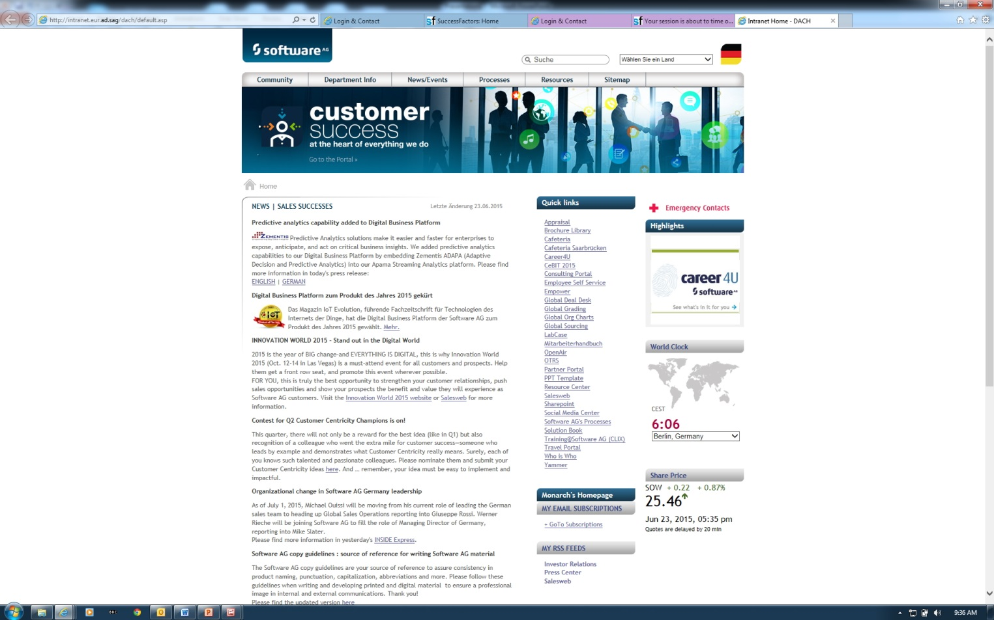
Referral Process for employees
You can reach the referral page in 2 ways:
First click on Career 4 U link – 5th link in “Quick links” on the home page!

Slide 3
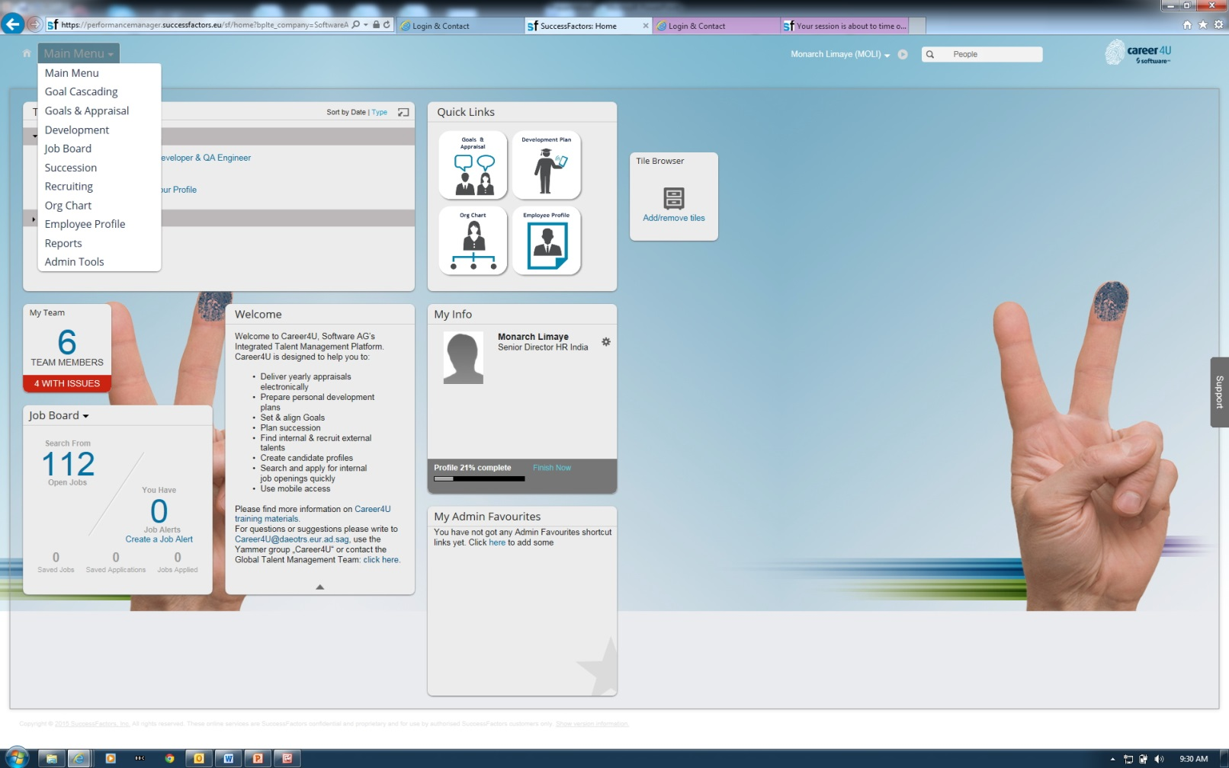
a) Either click as shown below on your home page for C4U:
Click on the Job Board Tab here

Slide 4
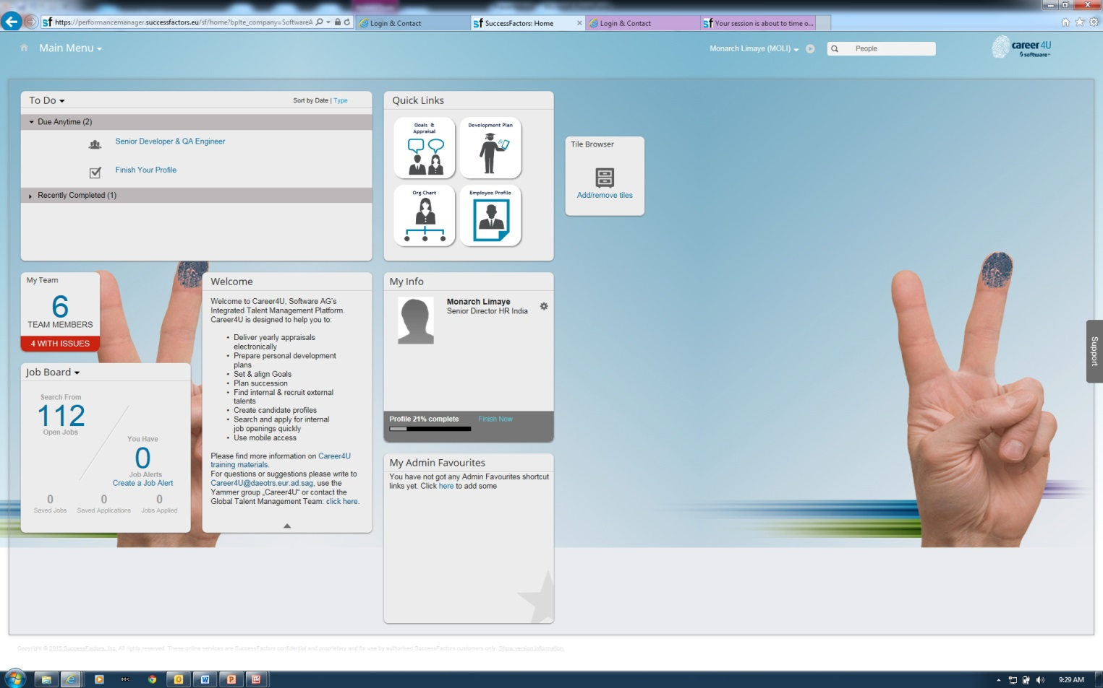
b) Or, click on the Job board section as indicated below!
Click on the Job Board Tab here

Slide 5
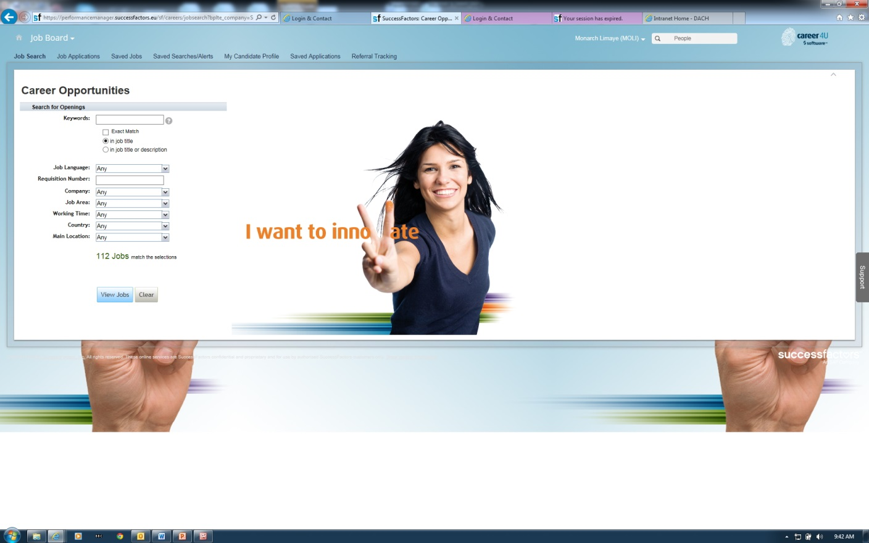
Here in the column “Requisition Number”, key in the Requisition No” as indicated in the referral mail
Fill in the Requisition Number here

Slide 6
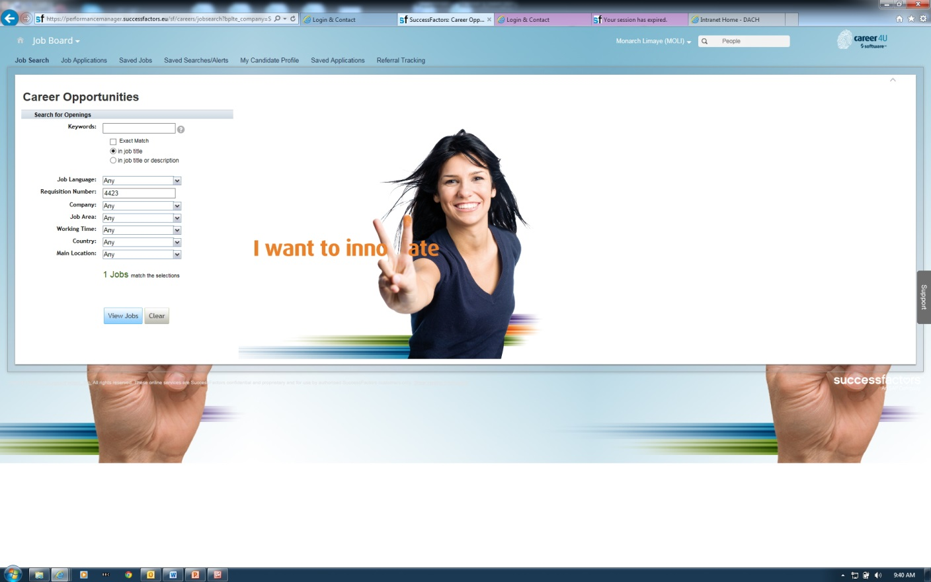
Once you enter the requisition number , click on the “View Jobs” Tab to view the job you are referring against
Click here

Slide 7
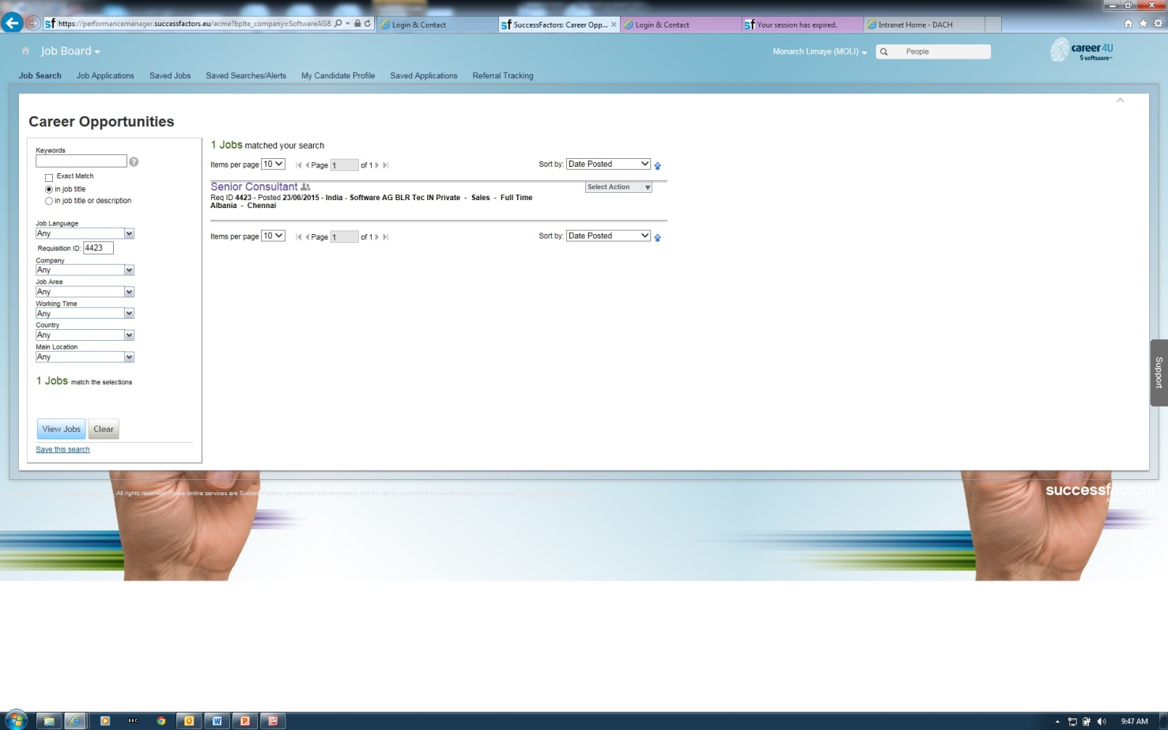
Click on “Select Action” Tab
Click here

Slide 8
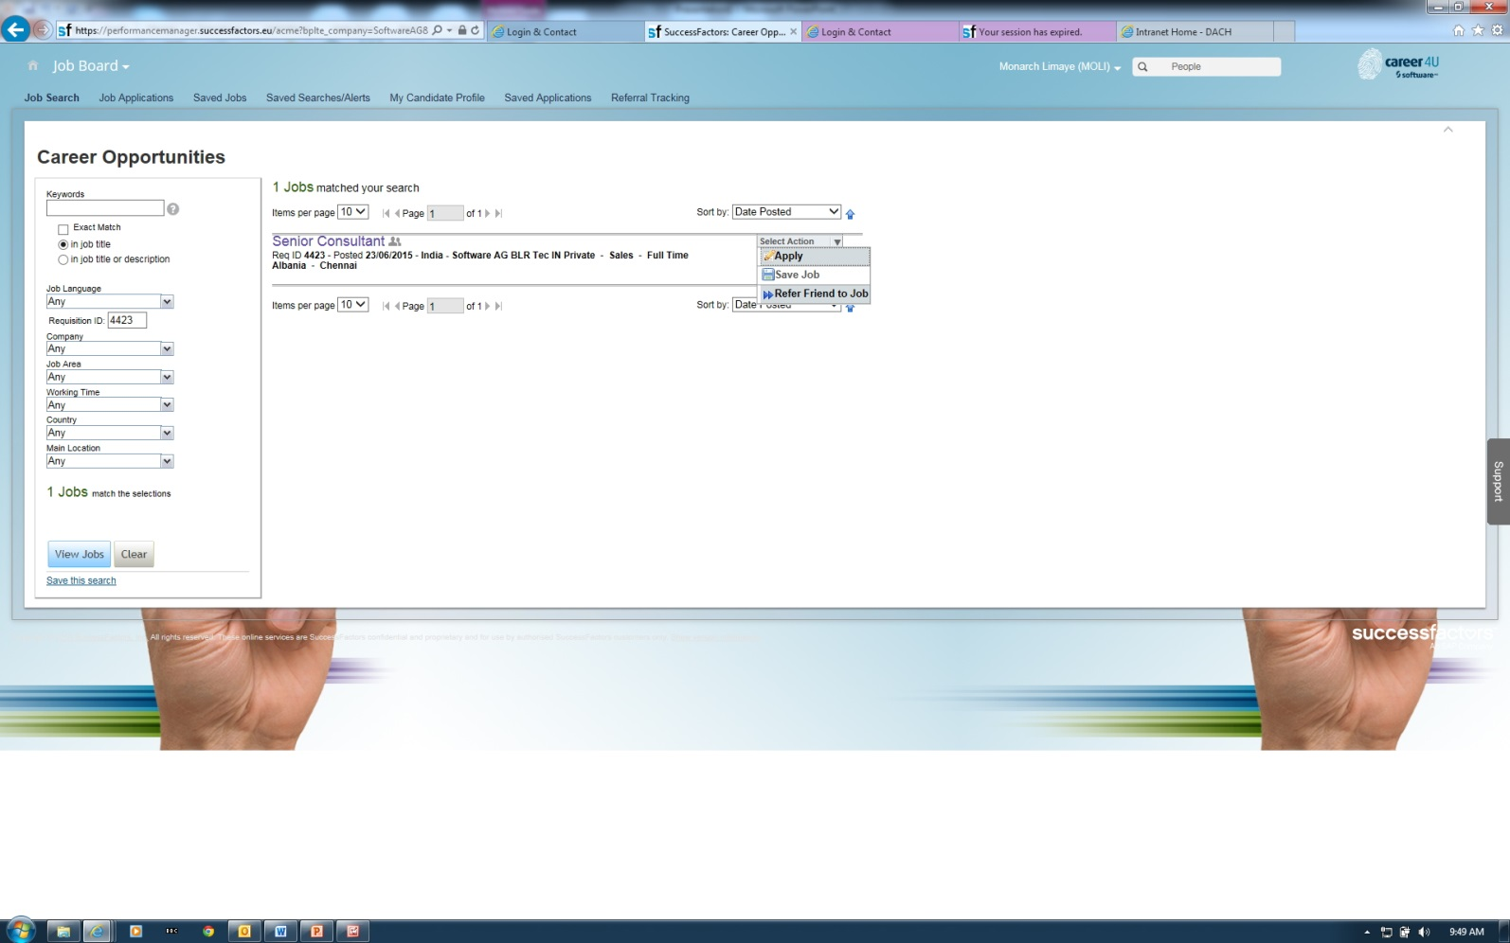
After clicking “Select Action” tab as mentioned earlier, please click on “Refer Friend to Job”
Click here to refer friend

Slide 9
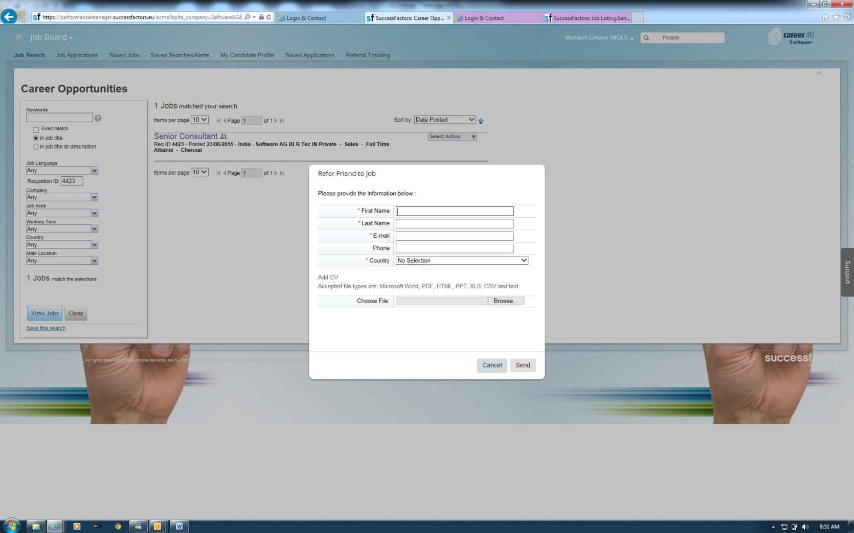
Fill in Basic details of the person you are referring . These will include –
-First name, Last Name, e-mail, Phone and country (India by default)
- Upload CV and click on “Send button”
Fill basic details here
Upload CV if you have it

Slide 10

Your referral is now submitted .
You can track your referral by clicking on “Referral Tracking” tab
Click here to track your referrals

Slide 11
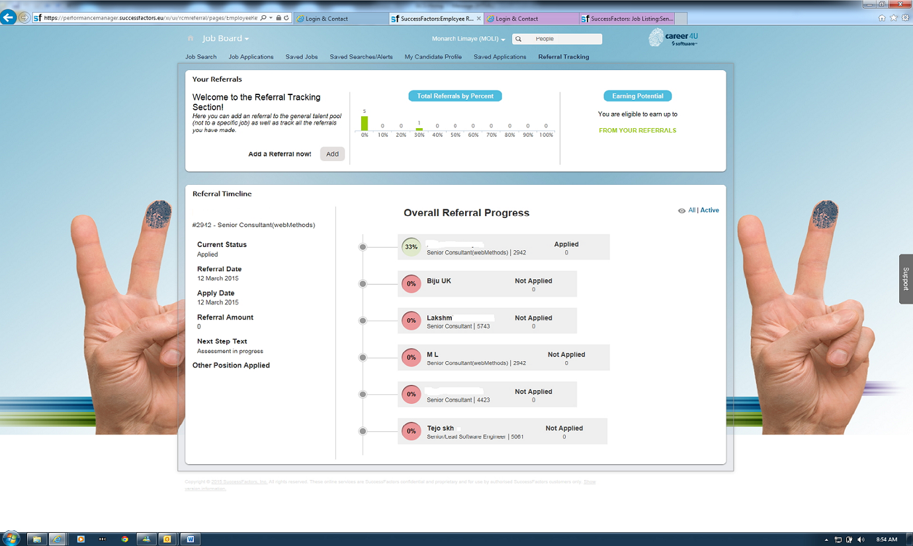
Snapshot of how your referral tracking screen will look like this!

